Slide 1
Personal Finance Tracker Web App
Description:
A simple web application that helps users track their income and expenses.
Users can log transactions, categorize them, and view summaries like total income, expenses, and current balance.
Data Managed by the Application:
- Transactions (income or expense)
- Categories (e.g., Rent, Groceries)
- (Optional) User information (for login)

Slide 2
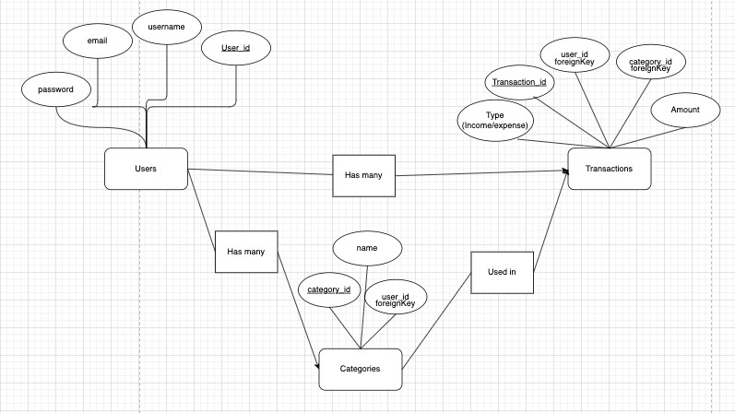
Envisioned E/R Diagram
Entities:
Users(user_id PK, username, email, password_hash)
Categories(category_id PK, user_id FK, name)
Transactions(transaction_id PK, user_id FK, category_id FK, amount, type, date, description)
Relationships:
- One User has many Transactions
- One User has many Categories
- One Category is used by many Transactions

